Slide 1
Data Quality and Data Sources
Validation Objective
Confirm that the data used for the approach development and data inputs are consistent, sufficient, and extracted from reliable sources.
FLU’s Proposal
The proposed approach used daily balance of unfunded facility from Jan 2015 to June 2019. (5 year - 2396 business days)
Data was obtained from limit table in DataMart and aggregated by customer rating and industry sector.
Validation Rational and Conclusion
Reliability | Consistency | Sufficiency
Data used for the approach development was extracted from DATA_MART_US, which should be considered as reliable data source based on CDO’s EPS data quality report. | The relevant retrieved data could be reconciled with T_FMDDATA_HIST data table and ALCO reports on month-end basis. | The proposed 5-year time horizon provides sufficient data (150,716 data points) for LST assumption development. The covered horizon is most relevant to the Bank’s current business portfolio and complexity. In addition, the volume of the unfunded facility during 2007-2009 financial crises is not relatively comparable to the Bank’s current size.
Acceptable | Acceptable | Acceptable

Slide 2
Theory and Assumptions
Proposal from FLUs
Business Profile: Unfunded loan commitments are commitments made by BOCNY to customers that are contractual obligation. These facility primarily granted to investment grade companies, including both corporates and financial institutions.
Liquidity Impact: customers could draw on committed facilities during a stress period to preserve their access to cash or fund a shortfall in cash flow.
Unfunded Commitment
Credit Facility
Liquidity Facility
Used for daily operations as working capital
Utilize to cover debt obligations (e.g. CP) that were unable to be rolled
1
Main Assumptions Summary
Segmentation Schema and Risk Factors | a) Facility Type Credit Liquidity | b) Customer Rating High Moderate Low | c) Industry Sector Energy Manufacturing Real Estate Others
Approaches to modeling drawdown rate | Numerator Total drawdown outflow during stress horizon | Denominator Unfunded commitments as of D0 Facility limit increase during stress horizon
Stress Simulation | Systematic: 90th percentile | Idiosyncratic: 93rd percentile | Combined: 95th percentile
3
2
4
5

Slide 3
Theory and Assumptions
Effective Challenge 1 - Drawdown Spikes: Certain unexpected large drawdown (spikes) were observed in historical data. What are the underlying drivers for these high usage of unfunded committed facilities?
MRD Evaluation:
Business Interview: A case study was conducted for these credit line drawdown spikes
Spike Underlying drivers:
Corps with liquidity backup facilities: merge and acquisition activities
Financial Market Utilities: minimal testing draws and repaid right after
Conclusion: Acceptable. The drawdown spikes are meaningful data that reflect historical large draws on unfunded commitments. These spike data should be include in the approach development to simulate stress scenarios.
1

Slide 4
Theory and Assumptions
Effective Challenge 2 – Key Risk Factors: How the tow risk factors (customer rating and industry) were determined? Is there any other risk factors have been considered or incorporated during the approach development? (facility tenor, revolving feature, product type etc.)
MRD Evaluation:
Customer rating and Industry Sector: Recommended by regulator
Tenor: Most (86%) of facilities’ tenor are over 1 year
Revolving Feature: Most (91%) of facilities are revolver
Product Type: Duplicated with industry sector factor
Conclusion: Acceptable. Customer rating and industry sectors are the most appropriate key risk factors for credit portfolio segmentation based on the Bank’s current business profile and complexity.
Effective Challenge 3 - Segmentation Scheme: What is the segmentation rational for customer rating ‘moderate’ and industry sector ‘Others’?
MRD Evaluation:
Moderate: Unique utilization rate (43% vs. high rating 8%) and drawdown pattern
Others: Most of facilities are concentrated on top 3 industries. (manufacturing: 38%, energy: 29% and real estate: 8%)
Conclusion: Acceptable but ongoing monitoring are recommended.
2
3

Slide 5
Theory and Assumptions
Effective Challenge 4 - Drawdown Rate Approach: Is the current drawdown rate approach conceptually sound? Is there any alternative approaches for the Bank?
MRD Evaluation:
Conservative: Accumulative BAU total cash outflow as stress drawdown
Alternative approach 1 - Life Cycle Utilization: Only suitable for non-revolving facilities with drawdown schedules
Alternative approach 2 - Peak and Valley: Only fits revolving facilities with clear patter of drawdown and repayment
Conclusion: Acceptable. Considering the conservative nature and high efficiency, the proposed approach is deemed as the most suitable to the Bank’s current liquidity risk management practices.
4

Slide 6
Theory and Assumptions
Effective Challenge 5 - Stress Scenario: What is the rationale for the stress severity design regarding systematic and Idiosyncratic scenarios? What is the linkage of three stress scenarios and the drawdown assumptions?
MRD Evaluation:
Account nature and Customer Behavior: Varying levels of sensitivity to different stress severity
Systematic Stress: Facility customer is more sensitive to the collapse in market liquidity.
Idiosyncratic Stress: Early drawdown were rarely observed due to the Bank’s high credit rating.
Systemic Stress Testing Scenario Description: Unsecured funding markets are non-existent for a period of six months. Moreover, the associated credit crisis would result in the shrinking of interbank money market funds and an increase in drawdowns on committed lines.
Conclusion: Suggest reverse percentile level design for idiosyncratic and systematic stress scenarios.
5

Slide 7
Analysis and Calculation
Proposal from FLUs
Formula:
Drawdown rates for all 13 sub-categories
1
Unfunded Commitment |  | 14-Day |  |  | 30-Day
Type | Sub-category | Systemic | Idiosyncratic | Combined | Systemic | Idiosyncratic | Combined
Liquidity | Liquidity Facility | 0.79% | 1.05% | 1.19% | 1.48% | 1.77% | 10.20%
Credit | Energy + High | 2.29% | 3.70% | 4.17% | 5.17% | 7.23% | 8.56%
 | Energy + Moderate | 10.22% | 28.16% | 32.55% | 35.96% | 37.20% | 42.02%
 | Energy + Low | 0.08% | 1.21% | 15.30% | 13.55% | 30.04% | 32.13%
 | Manufacturing + High | 2.80% | 3.00% | 3.87% | 5.49% | 8.52% | 9.91%
 | Manufacturing + Moderate | 5.32% | 7.31% | 8.21% | 9.72% | 11.86% | 12.77%
 | Manufacturing + Low | 1.41% | 12.30% | 25.48% | 25.48% | 61.32% | 63.07%
 | Real Estate + High | 10.20% | 21.98% | 35.84% | 37.77% | 54.15% | 79.83%
 | Real Estate + Moderate | 10.88% | 21.57% | 24.45% | 25.41% | 37.30% | 40.79%
 | Real Estate + Low | 5.54% | 9.62% | 12.91% | 20.13% | 33.84% | 35.88%
 | Others + High | 1.55% | 1.98% | 2.92% | 3.06% | 4.66% | 5.66%
 | Others + Moderate | 9.68% | 13.98% | 16.52% | 20.67% | 25.77% | 27.38%
 | Others + Low | 0.99% | 1.31% | 4.91% | 4.91% | 7.09% | 10.17%
2
3

Slide 8
Analysis and Calculation
Effective Challenge 1 – What is the rational of the drawdown rate calculation considering facility limit and unfunded exposure changes caused by new approve , mature and actual debt repayment activities?
MRD Evaluation:
New approved facilities: defined as unfunded exposure before it converts to loans
Mature: only count for D0 and exclude cash inflow during 14D/30D
Debt Repayment: excluded such cash inflow and unfunded exposure increase impact to fit appropriate conservative
Example:
Conclusion: Acceptable.
1
Day | Total Facility | Outstanding Loan | Available Amount | Activities (reflect in calculation)
0 | 100 | 40 | 60 | N/A
1 | 100 | 55 | 45 | Drawdown 15 (cash outflow include in formula)
2 | 100 | 30 | 70 | Debt Repayment 25 (cash inflow exclude in formula)
3 | 150 | 30 | 120 | New Approve 50 (limit increase include in formula)
4 | 150 | 80 | 70 | Drawdown 50 (cash outflow include in formula)
5 | 100 | 80 | 20 | Mature 50 (facility limit decrease exclude in formula)
6 | 120 | 80 | 40 | New Approve 20 (No change in formula)

Slide 9
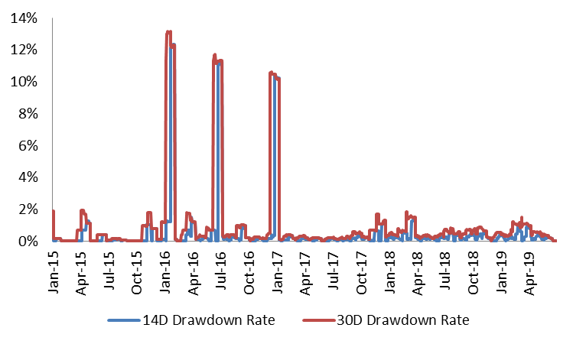
Analysis and Calculation
Effective Challenge 2 – Why is the driver behind the 30D drawdown rate of liquidity facility, which is significantly higher than 14D drawdown rate?
MRD Evaluation:
Historical Drawdown and distribution: 30D drawdown rate is 0.6% higher than 14D in average
Dramatic increases at 95th percentile:
30D drawdown rate jumped from 1.9% to 10.2%
14D 30D drawdown rate has a similar pattern at 98th percentile (from 1.4% to 10.3%)
Conclusion: Acceptable.
2

Slide 10
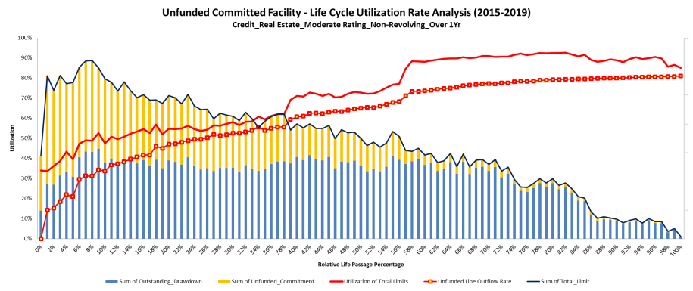
Analysis and Calculation
Effective Challenge 3 – What is the unfunded exposure used to derive the large drawdown rate regarding the real estate segmentation?
MRD Evaluation:
Construction Loan:
Conclusion: Acceptable.
3

Slide 11
Appendix

Slide 12
Appendix
Credit Lines | Customer | Average | Peak | Unexpected Drawdown | Spike Usage Purpose
Corp with Liquidity Backup Facilities | Marriott | 19.91% | 73.78% | 53.87% | For general corporate purpose. Unexpected large usage are mainly due to merge and acquisition activities.
 | Comcast | 3.02% | 23.10% | 20.08%
 | SCE | 5.40% | 22.33% | 16.93%
 | CommonSpirit | 27.58% | 33.94% | 6.36%
 | MasterCard | 10.89% | 16.67% | 5.78% | Drawn on the Revolving Commitments
 | FMC | 8.10% | 13.47% | 5.37% | L/C usage
 | AT&T | 19.19% | 22.91% | 3.72% | Term Loan Drawdowns
 | Disney | 3.22% | 4.51% | 1.29% | Merge/Acquisition
Financial Market Utilities | OCC | 1.03% | 5.00% | 3.97% | FMUs only had minimal testing draws from the credit lines and repaid right after the draws.
 | CME | 0.09% | 0.21% | 0.12%
 | NSCC | 0.07% | 0.07% | 0.00%
 | DTC | 0.00% | 0.00% | 0.00%

